Slide 1
WE HALAL
Trust in Halal, trust in us

Slide 2
01
Problem statement

Slide 3
Problem statement
The current event management system is currently lacking consistent labelling of halal products, which can lead to confusion of different halal products labelling by non-Muslim consumers. One of the main crucial problems faced by Muslim consumers in non-Muslim countries is the difficulty of finding halal-certified products. That results in making it too challenging for Muslim consumers to practice their faith and fulfill their religious commitment.
solve

Slide 4
02
Objective

Slide 5
objective
Our main objective is to help our brothers and sisters in the western world with the problems of nutrition, since they're no longer living in a place that shares the same culture or religious beliefs with them . We guide them to the unprohibited or the allowed foods that they could consume , by showing them the suitable restaurants available in their area on our application .

Slide 6
03
System scope

Slide 7
System scope
The reasoning behind this idea was that around 52% of Muslims that live in U.S.A have hard a time to know which products are Halal for consumption and what are not. Our Vision is that we help at least 30% of these people and reduce unlawful and haram consumption of these products without the consumer knowing and spread words about the problem in hope that other Organizations, Companies, and governments act as well.

Slide 8
04
Site visit report

Slide 9
Site visit report
The site visit showed that the Muslims who are living abroad faces the challenge of finding halal food, especially the meat products. This problem makes them struggle to maintain their Islamic traditions. So, to solve this problem, our project is to design an app which locates supermarkets and stores selling halal food. In addition, it enables them to check every product to see whether it’s halal or not by scanning its code.
Hello world !

Slide 10
05
functions

Slide 11
functions
registration | login by your email and password
ticketing | sales will be made in Muslim's events and feast
Attendee mangement | the employee confirms his attendance by his personal card
Payment processing | the payment will be encrypting the data before transmitting it and the customer will get his receipt in the e-mail
communication | we will update and notify if it is needed

Slide 12
functions
Venue(place) management | our headquarter is in Egypt ,and we export to 10 foreign countries around the world
Feedback and surveys | in our system there is the ability to write your feedback to satisfy the customers, develop the product, and address the negatives

Slide 13
06
ERD

Slide 14
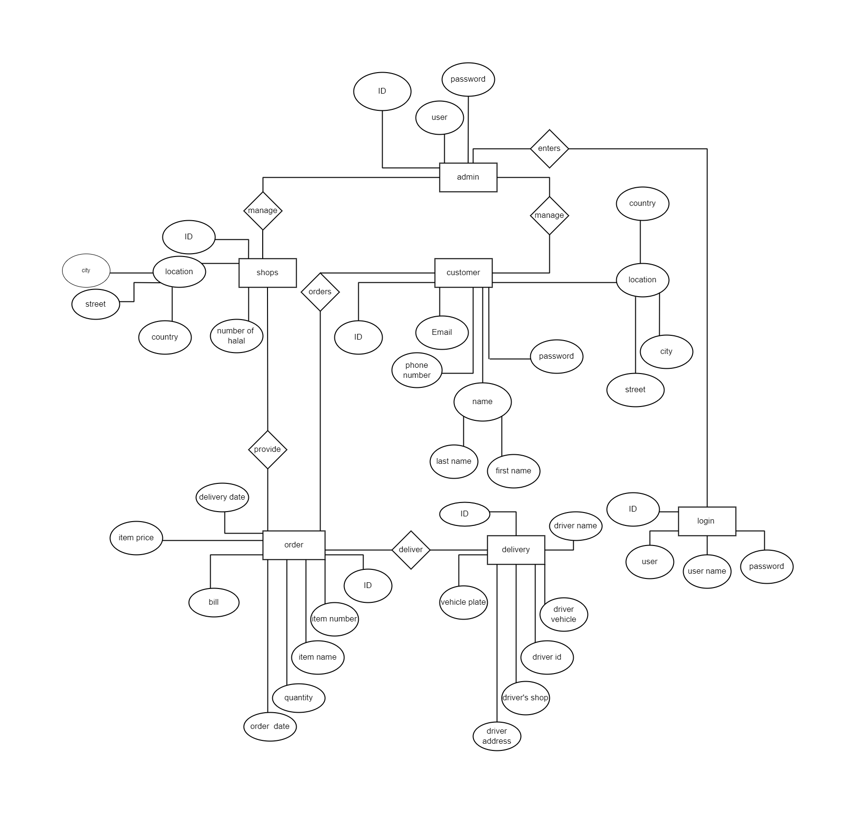

Slide 15
07
Power bi

Slide 16
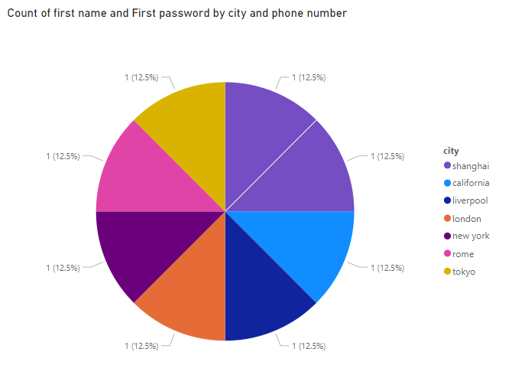

Slide 17
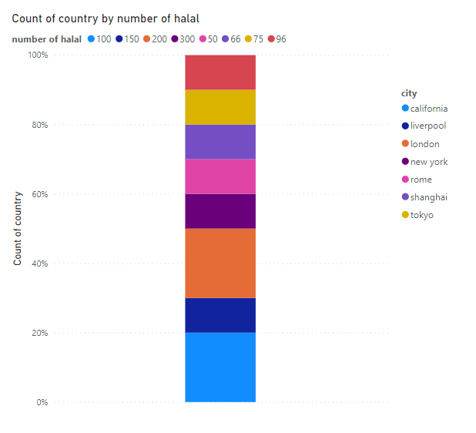

Slide 18
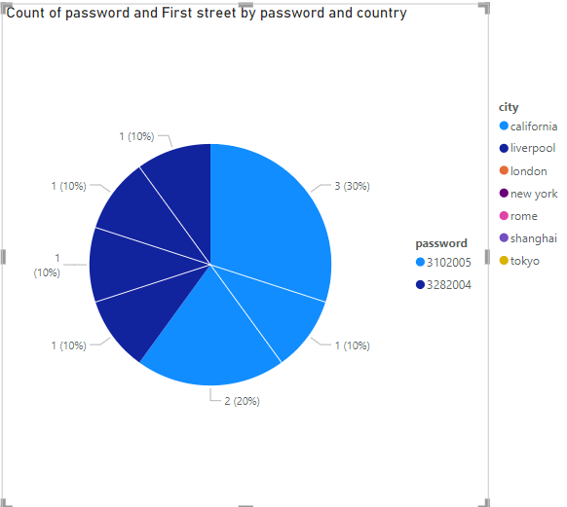

Slide 19
Thanks!

